Slide 1
EXPLORATORY DATA ANALYSIS OF LARGE-SCALE RETAIL TRANSACTION DATA
NextHikes IT Solutions
Presented By Sandeep Singh

Slide 2
1 Objective
Perform Exploratory Data Analysis (EDA)
Understand numerical and categorical variables
Identify patterns, relationships and distributions
Detect and interpret outliers
Analyze correlation, skewness and kurtosis
Generate meaningful business insights
Tools & Technologies
Python
Google Colab
Pandas
NumPy
Matplotlib
Seaborn
Dataset
Retail Transaction Dataset
100,000 Transactions
18 Columns
Numerical + Categorical + Date Variables
Retail customer, product, payment, delivery
and return information
4 My Contribution
Data cleaning & preparation
Feature engineering
Univariate analysis
Bivariate analysis
Multivariate analysis
Outlier detection
Correlation analysis
Statistical analysis
Business insights & recommendations

Slide 3
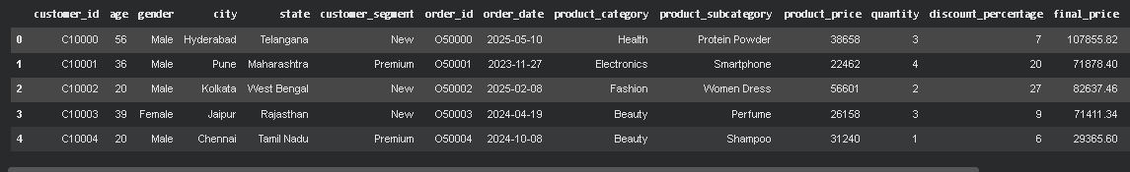
Dataset Overview
Dataset Summary
Dataset Size
100,000 Rows
18 Columns
Data Types
Numerical Variables
Categorical Variables
Date Variable
Main Data Areas
Customer Information
Product Information
Payment Details
Shipping & Delivery
Return Status
Transaction Value

Slide 4
Data Preparation & Target Variable
Data Preparation
Target Variable
Converted order_date into datetime format
Extracted Year, Month and Day
Created age_group
Created delivery_category
Created discount_category
Checked missing values and duplicates
Prepared numerical and categorical variables for analysis
Target Variable: final_price
final_price represents the final transaction value after considering product price, quantity and discount.
Then highlight:
Average Final Price: ₹64,165.72
Minimum: ₹357
Maximum: ₹239,980

Slide 5
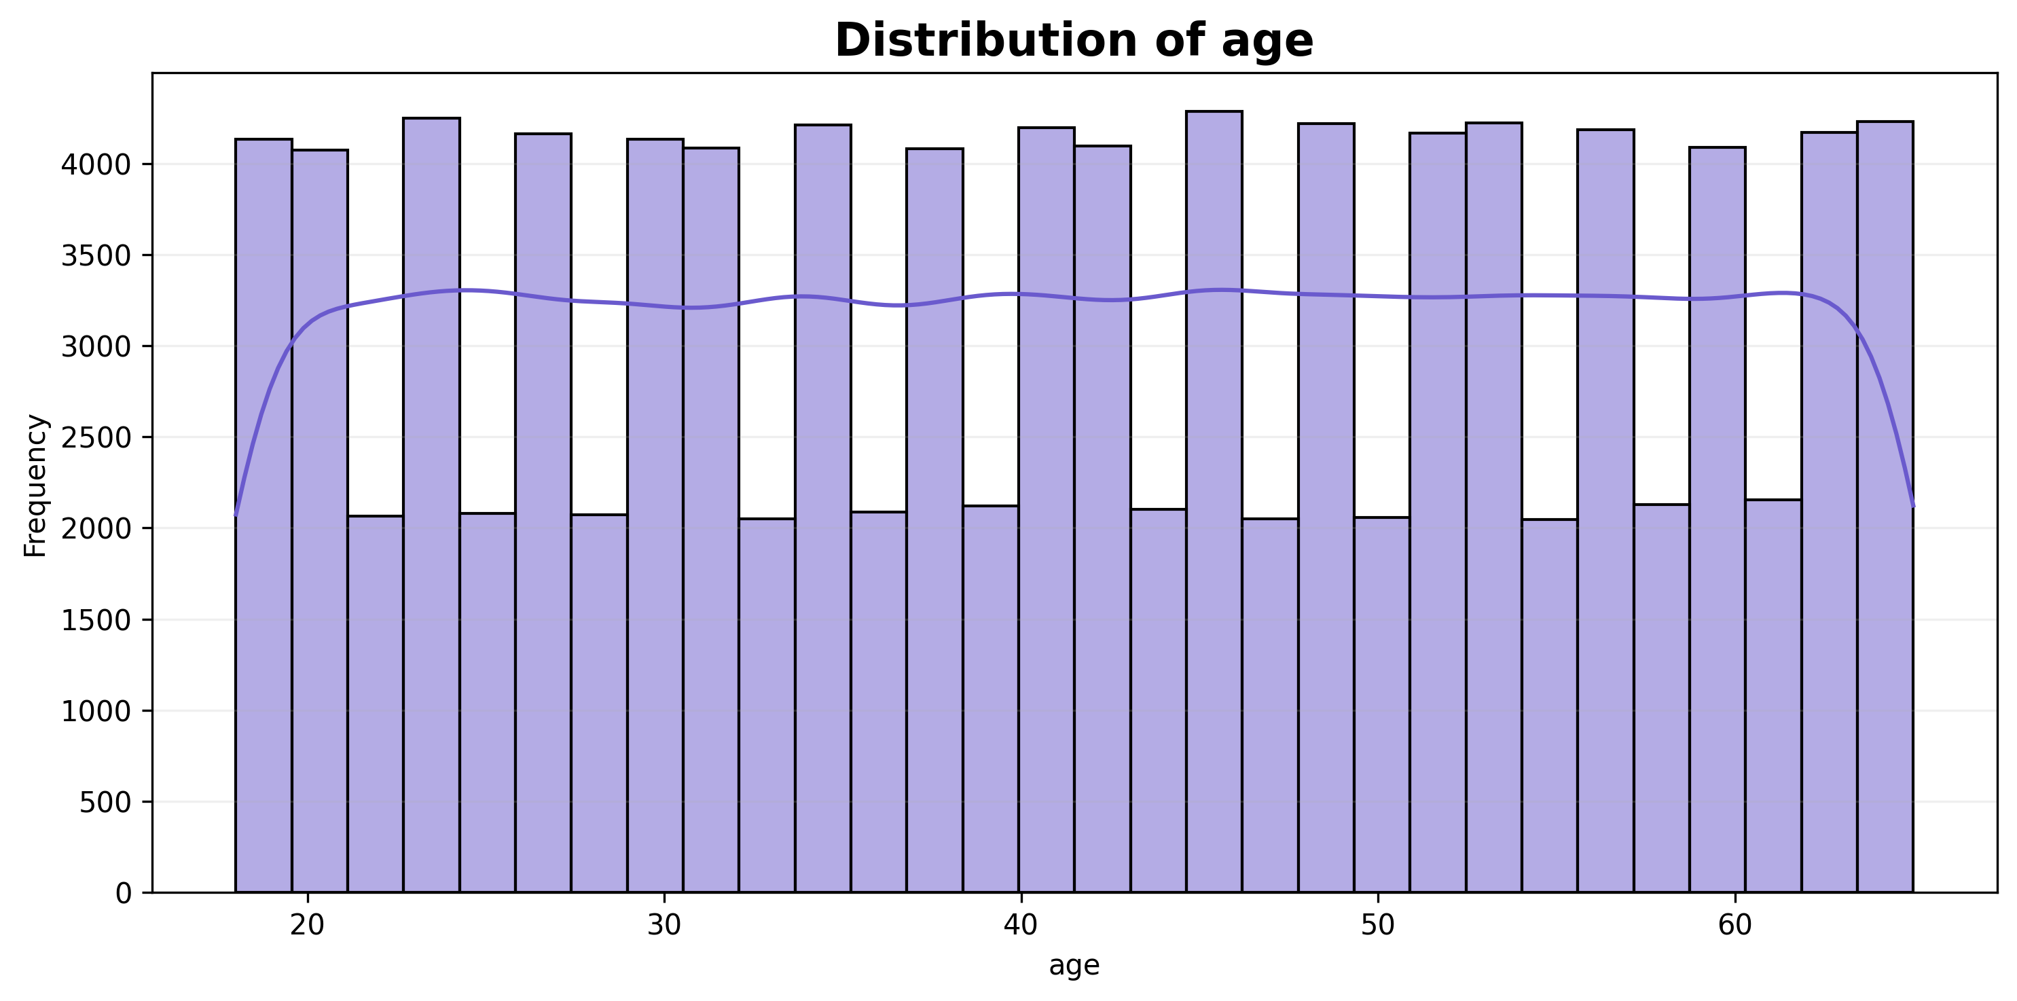
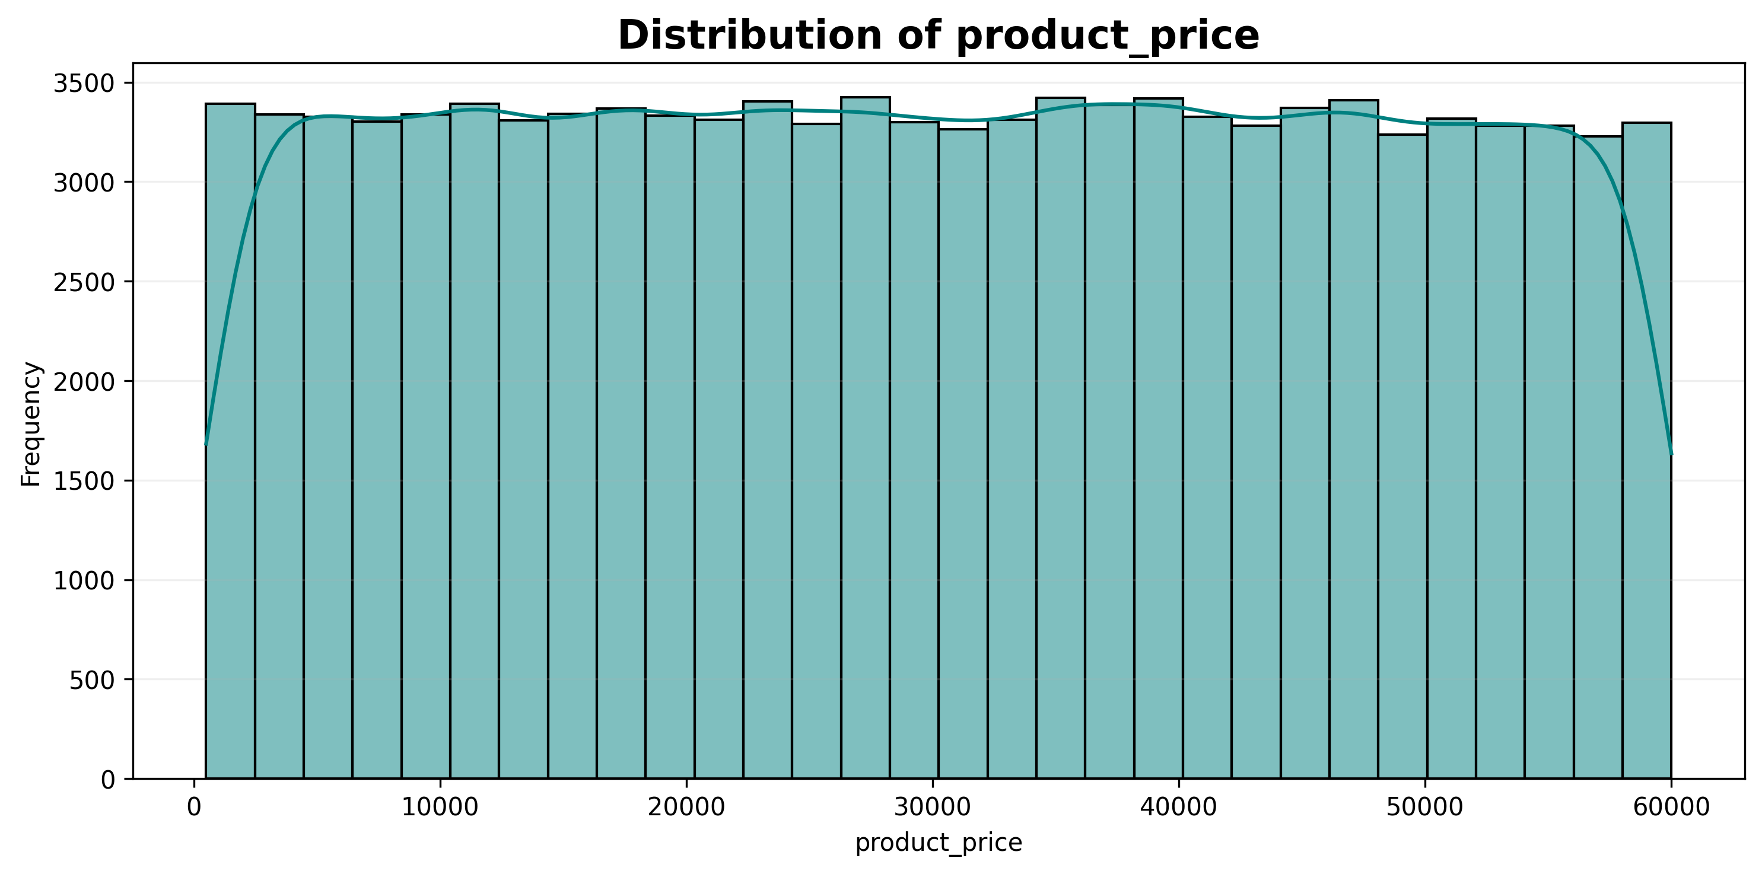
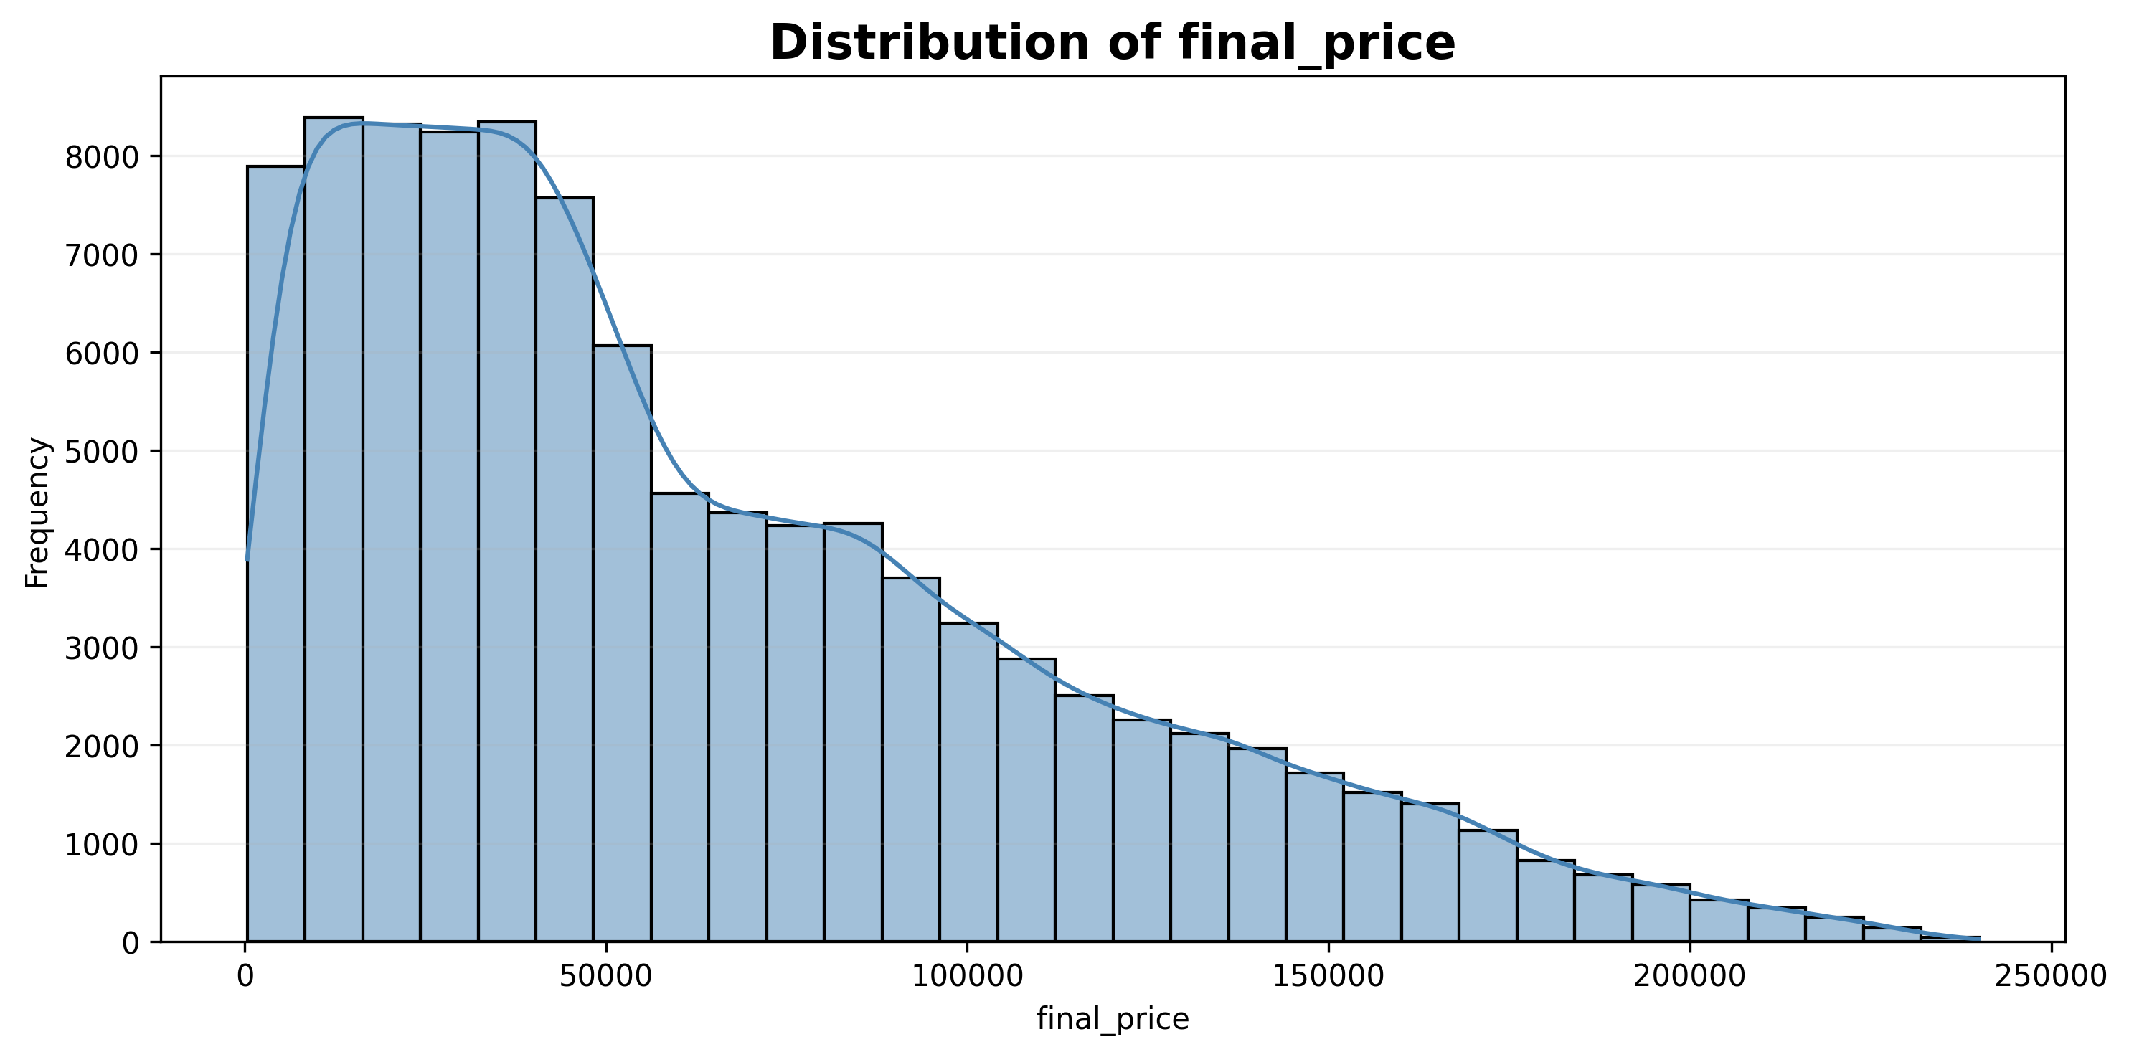
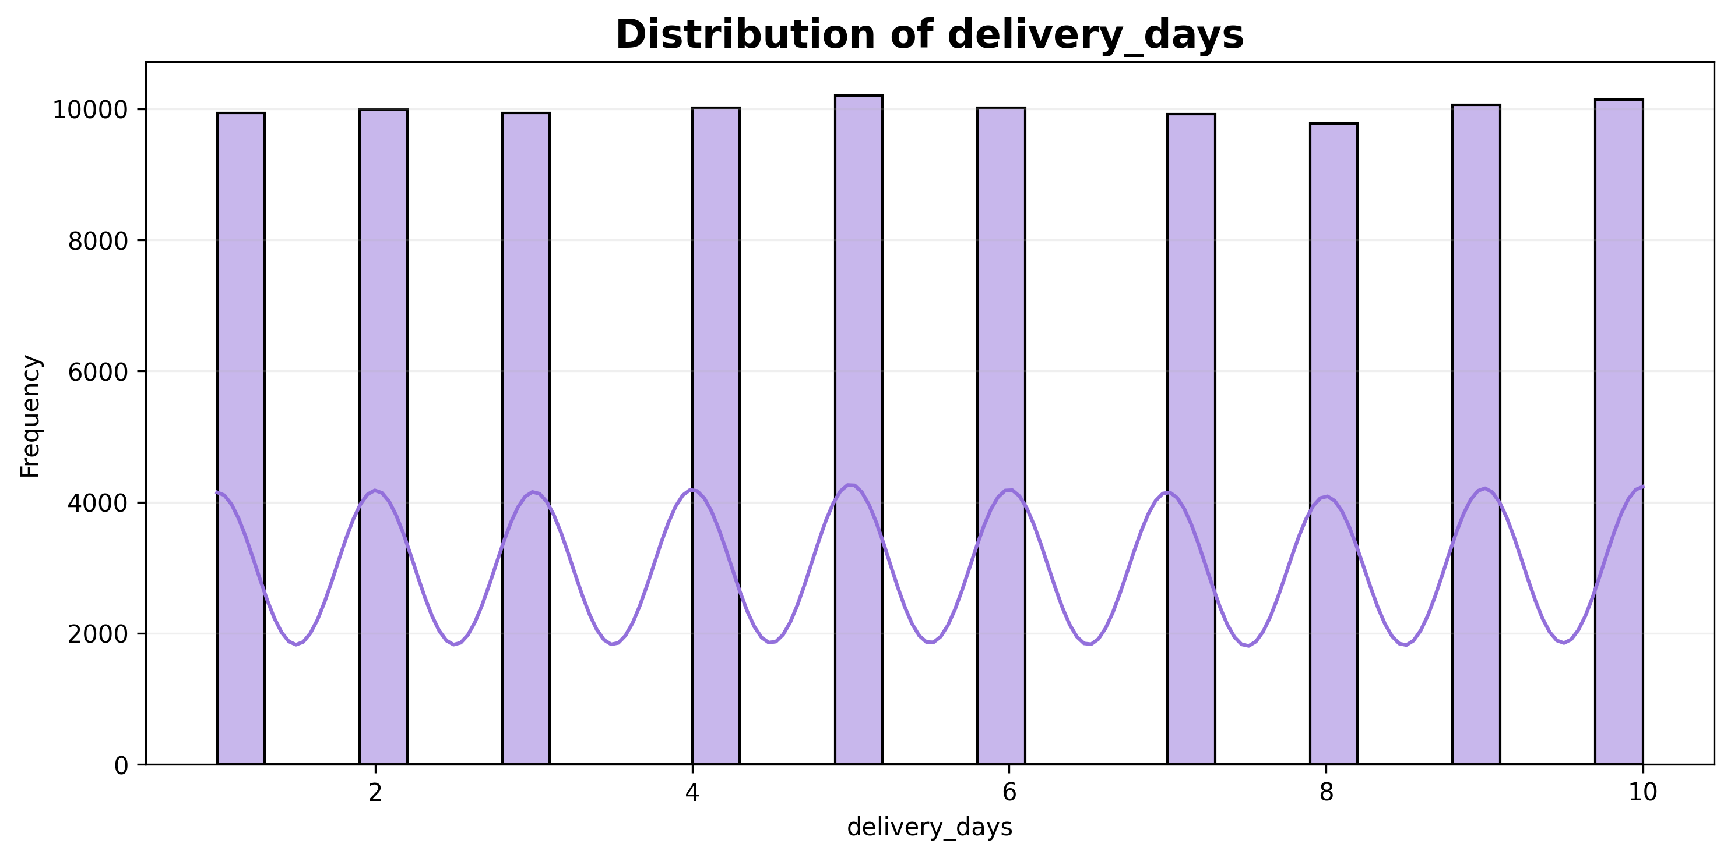
Univariate Numerical Analysis
Age, product price and delivery days show relatively balanced distributions. Final price is right-skewed, indicating some high-value transactions.

Slide 6
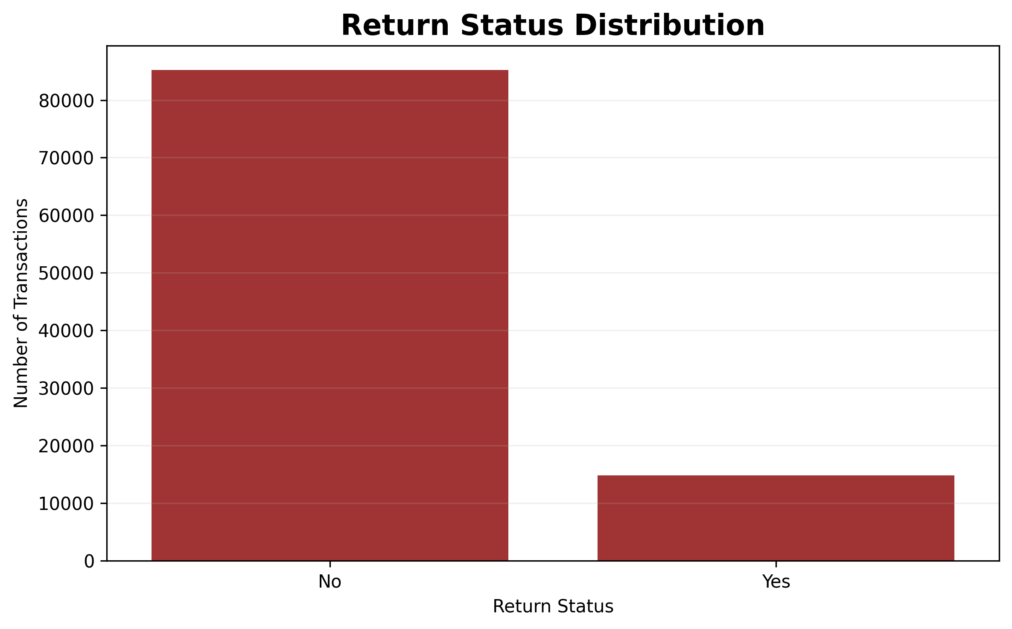
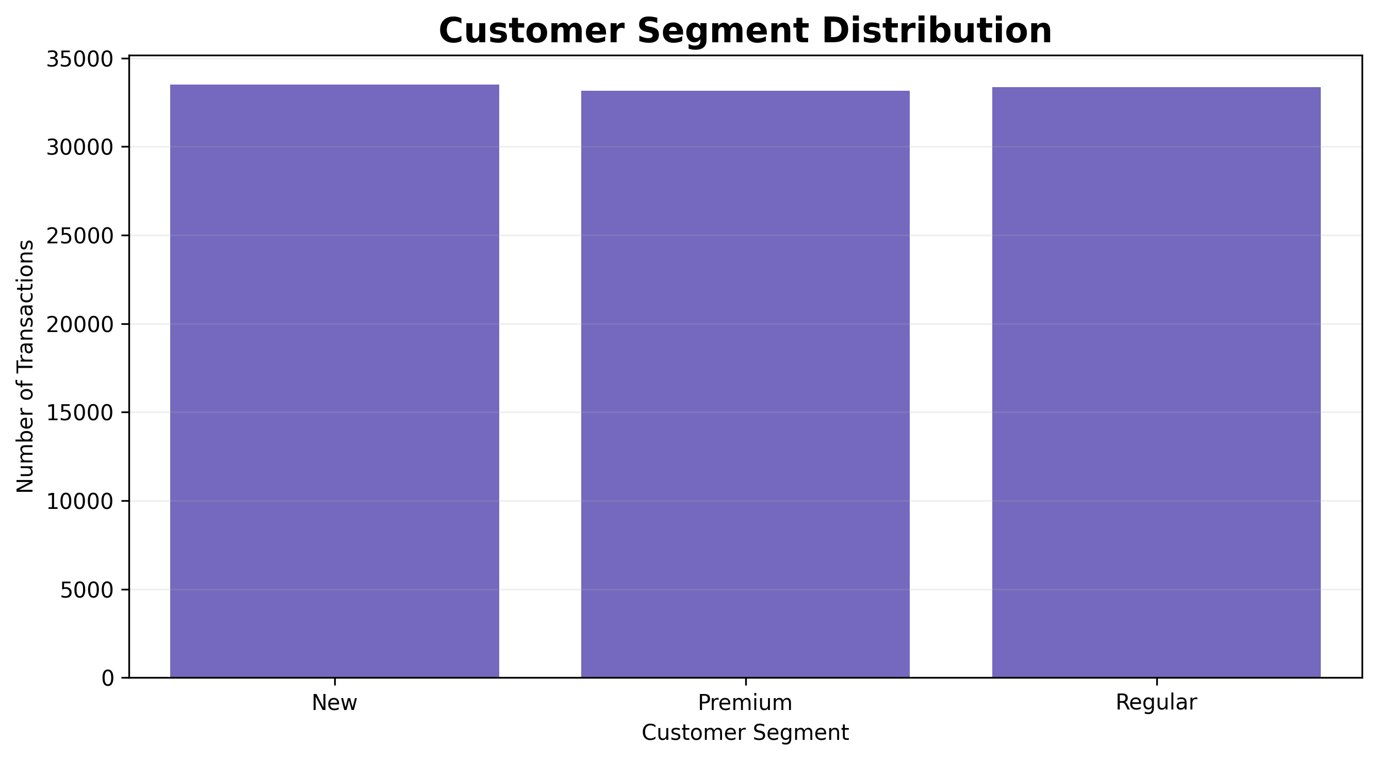
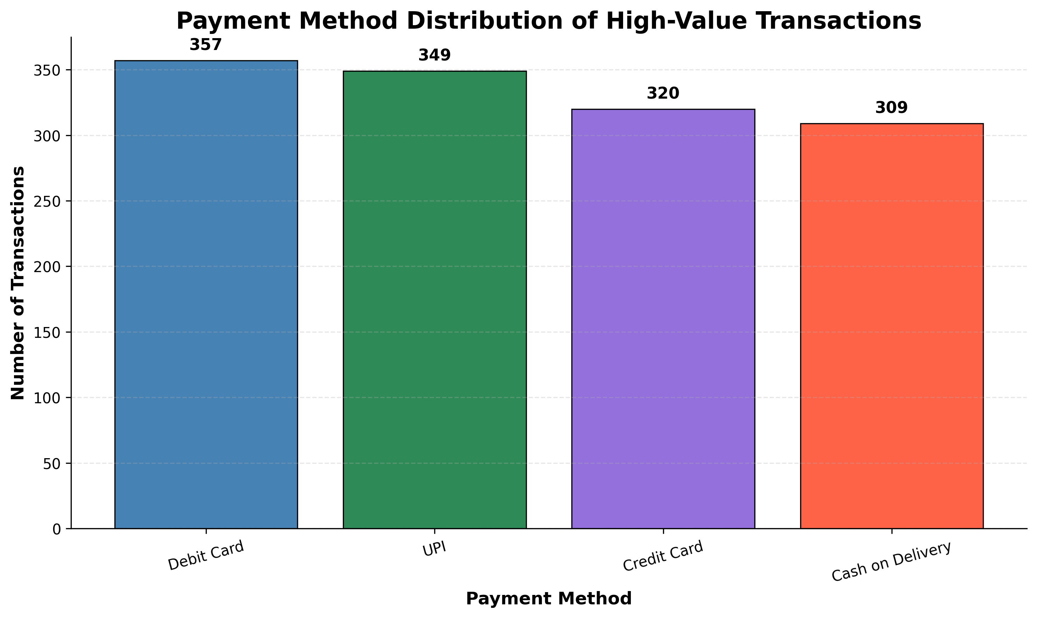
Univariate Categorical Analysis

Slide 7
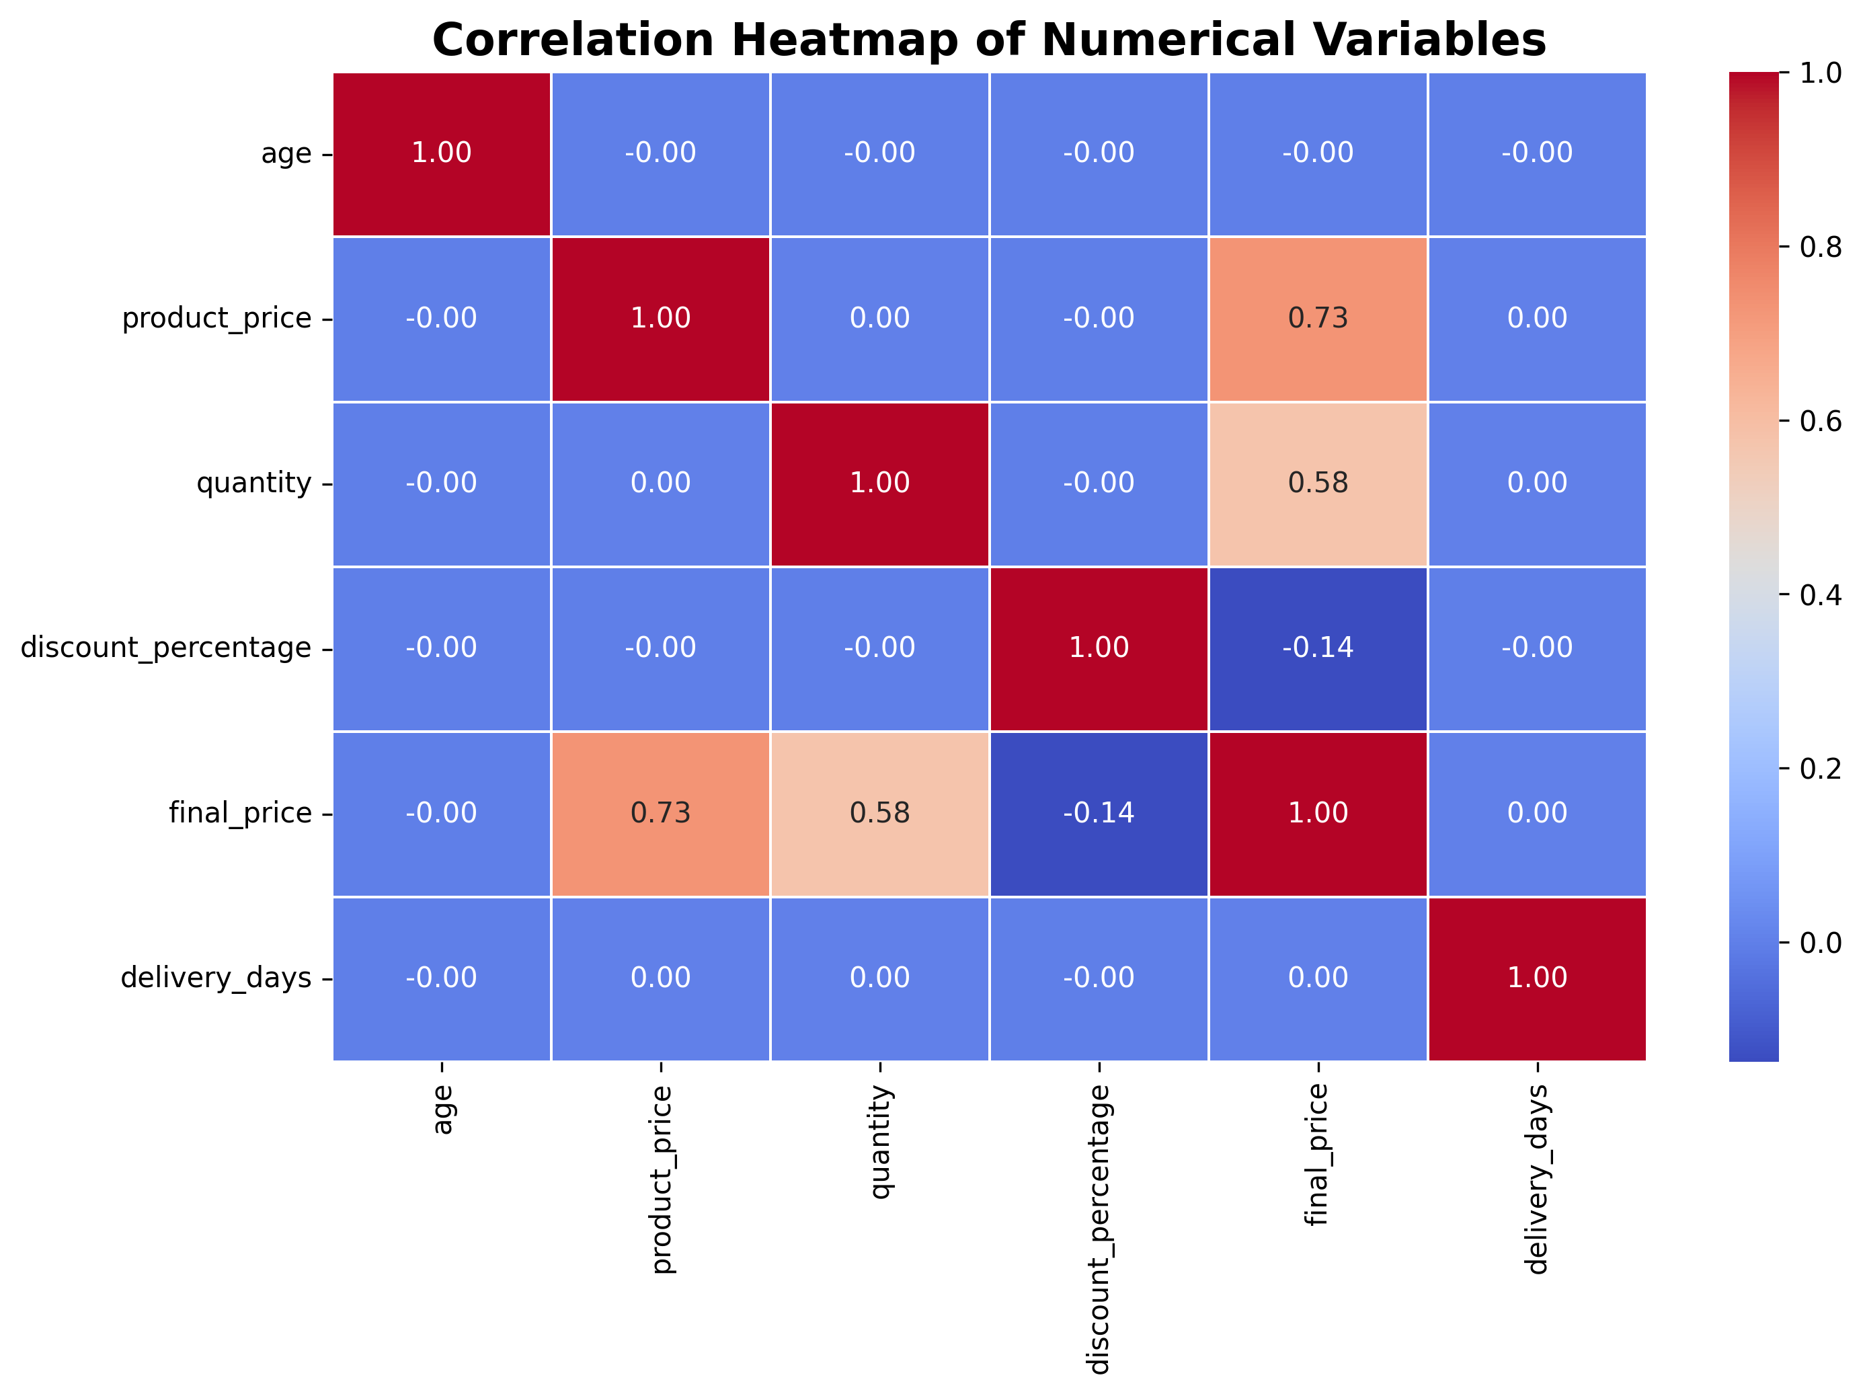
Correlation Analysis
Final Price has a strong positive correlation with Product Price and a moderate positive correlation with Quantity. Discount Percentage has a weak negative correlation with Final Price, while Age and Delivery Days show almost no linear relationship with Final Price.

Slide 8
THANK YOU
Presented By
Sandeep Singh

